Slide 1
Safe Harbor Statement
The analyst in this presentation are not financial advisers or brokers and do not offer financial advice based on your personal financial situation or goals and shall not be held liable for any investment or trading losses you may incur by using the information provided. This includes your trading the stocks mentioned on the Internet, various Internet chat rooms, message boards, video charts, in daily or weekly alerts or any other company publications. None of the information contained on messages in various Internet chat rooms, message boards, video charts, in daily or weekly alerts or any other company publications constitutes a recommendation to buy or sell a particular security. The content provided by the company is provided solely as an informational aid to your investment research and all investment decisions are solely the responsibility of the user. The information contained in any alerts, various Internet chat rooms, video charts, and other materials offered is believed to be accurate; however, we make no warranties or guarantees to its accuracy. All information is taken from SEC filings, company websites and Internet search engines and is believed to be deemed accurate and we take no responsibility if the information was not accurate and up to date.

Slide 2
Executive Summary
Our non-statistical sampling suggested equity markets initially overreact to unfavorable corporate news events of any one equity
We believe this is caused by two key factors:
Emotion
“People generally feel twice as much sadness or pain when something is lost than when something of equal value is gained. This is the main reason why stocks go down faster than they go up”
Technology
Mobile and automated technology has not only enabled news to propagate quickly but companies, individuals and bots to transact on that news instantly
Source: Why Stocks Tend To Decline Much Faster Than They Rise; http://theemotionallyintelligentinvestor.com/?p=145

Slide 3
Executive Summary
The market reaction typically causes a steep and rapid decline in price value
This is perpetuated until the security is viewed as ‘undervalued’
Then the market begins buying into the shares allowing a visible recovery to be seen
Source: Why Stocks Tend To Decline Much Faster Than They Rise; http://theemotionallyintelligentinvestor.com/?p=145

Slide 4
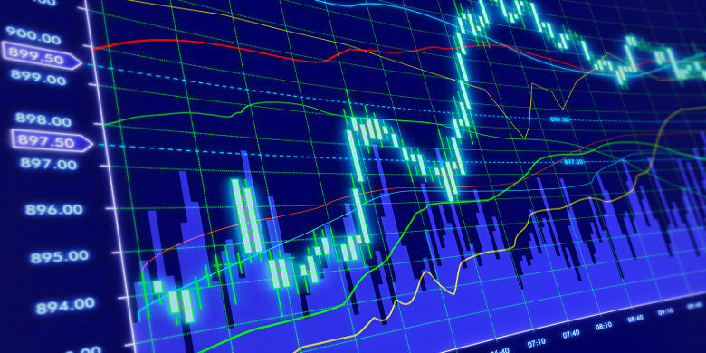
The Bounce
An analysis of the emotional stock volatility to corporate news worthy events and the buying opportunity and returns they present
Jan 24, 2018
Harshil Patel, Sean Slavin, Craig Bauer, Mariah McLaughlin

Slide 5
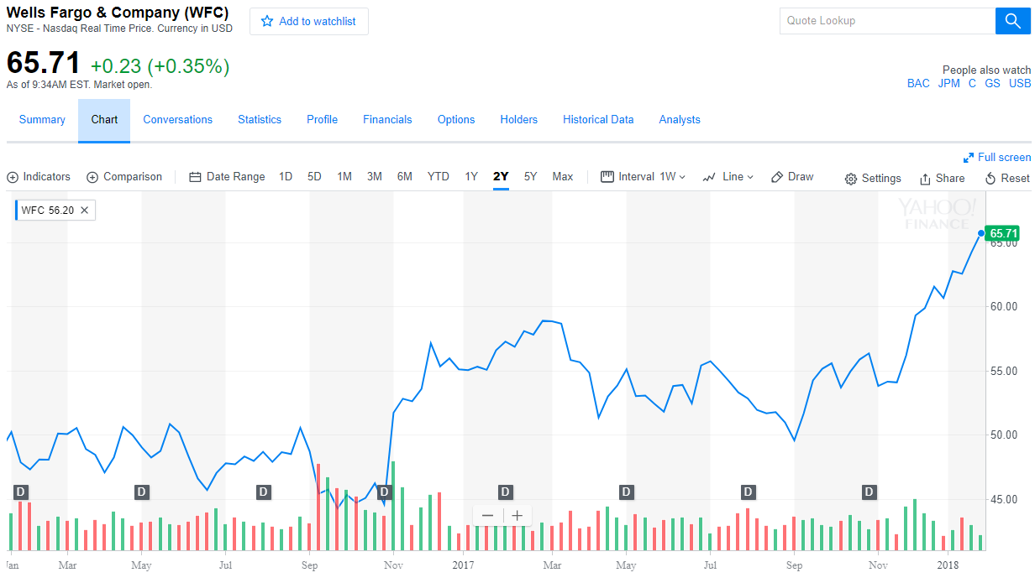
Product Failure, Service Failure or Fraudulent Practice
Wells Fargo: Consumer Financial Protection Bureau and the Los Angeles City Attorney and the Office of the Comptroller of the Currency fine $185 million for opening up over 2 million fake bank and credit card accounts in customers’ names without their knowledge or consent.

Slide 6
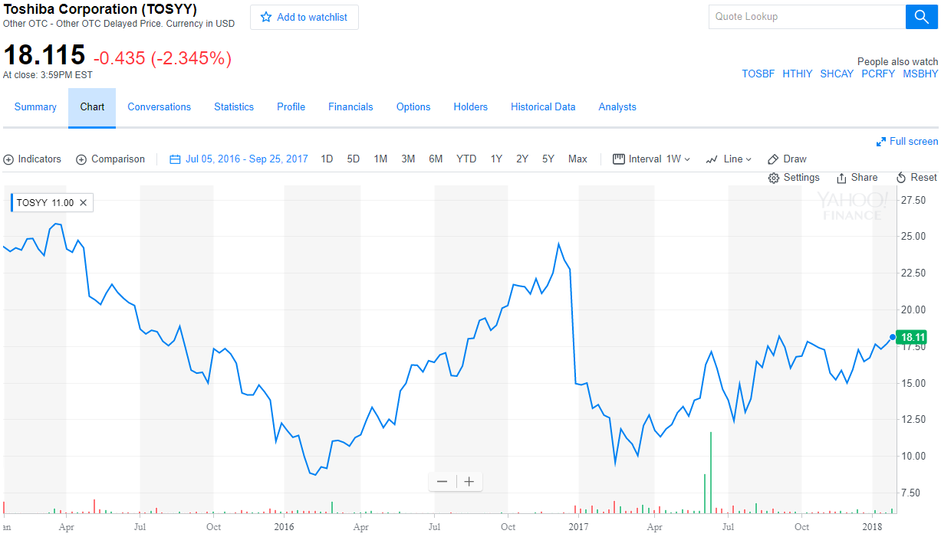
Accounting and Finance Misrepresentation
December 28, 2016 Toshiba’s U.S. nuclear-power subsidiary Westinghouse acquired CB&I Stone & Webster when Toshiba (TOSBF) was still struggling to recover from a $1.2 billion accounting scandal, then warned it is expecting billions of dollars in losses from its takeover

Slide 7
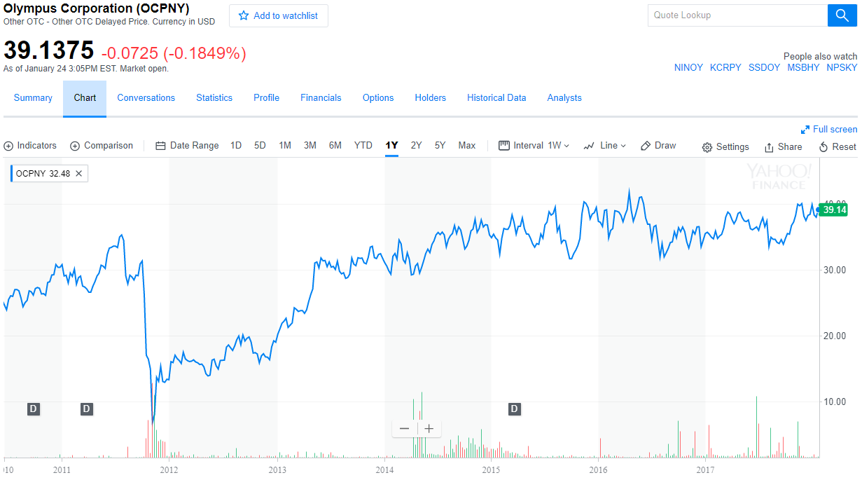
Accounting and Finance Misrepresentation
8 Nov 2011 Olympus admits hiding losses for 20 years. The firm, which has become engulfed by a scandal involving offshore payments that has attracted the attentions of the US Federal Bureau of Investigation, added that it may consider criminal complaints against former executives.

Slide 8
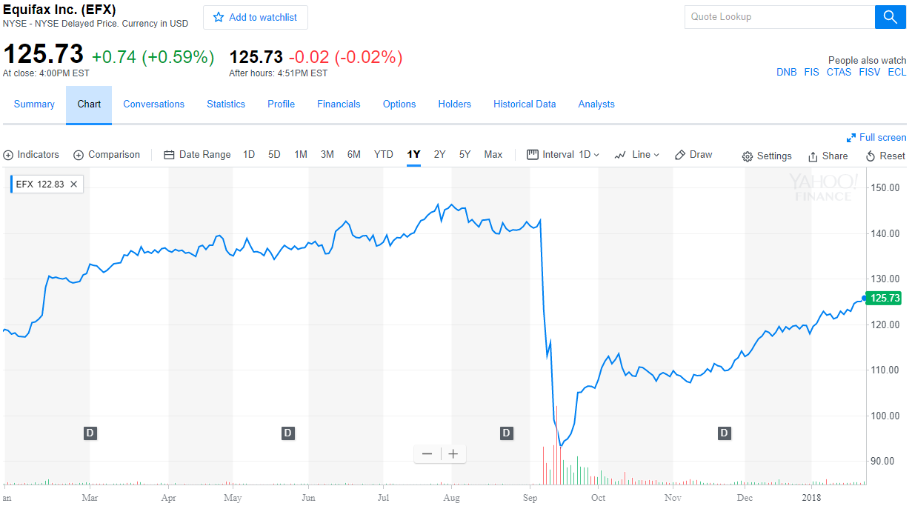
Product Failure, Service Failure or Fraudulent Practice
Credit reporting company Equifax suffered a breach in March, two months before the massive breach that hit as many as 143 million people

Slide 9
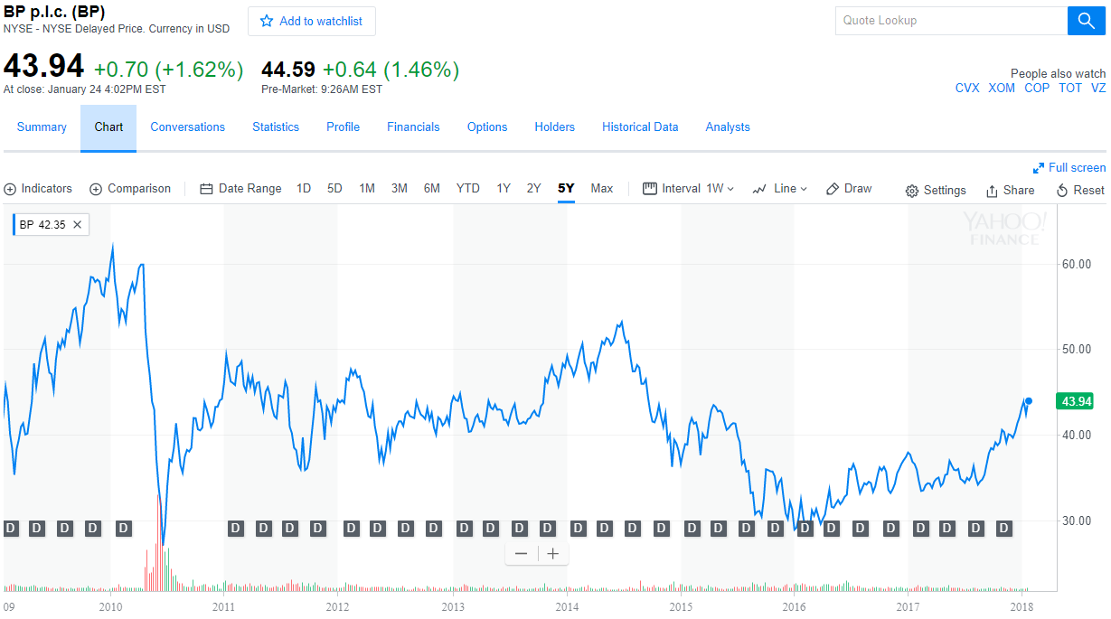
Environmental or Ecological Hazzard
April 21, 2010: The oil rig Deepwater Horizon, under contract with BP, exploded with catastrophic results.

Slide 10
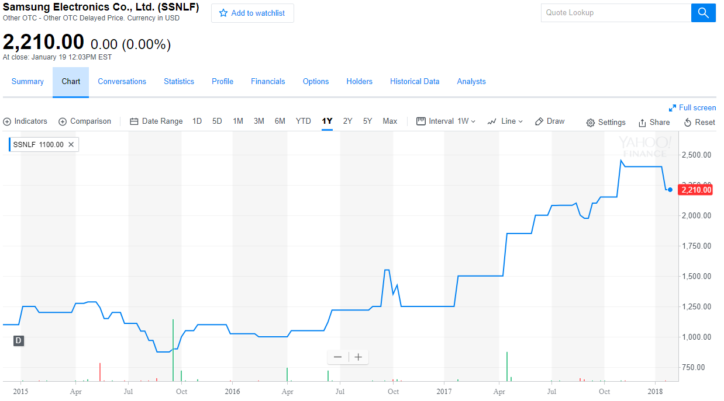
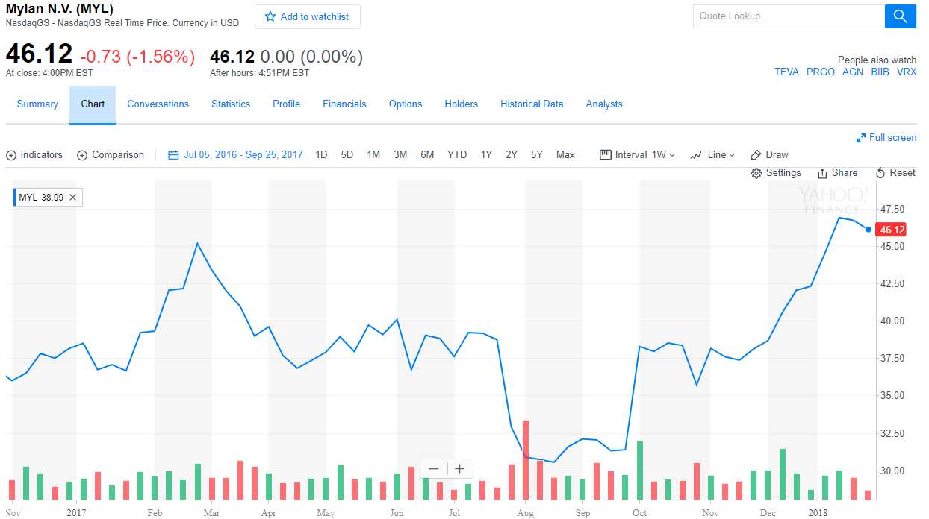
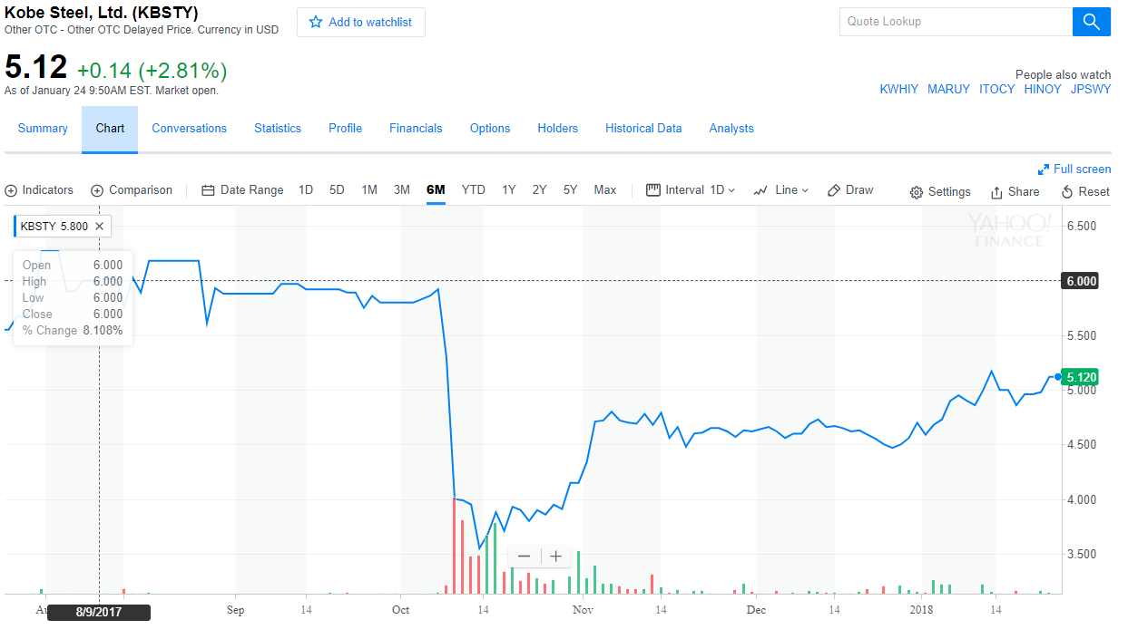
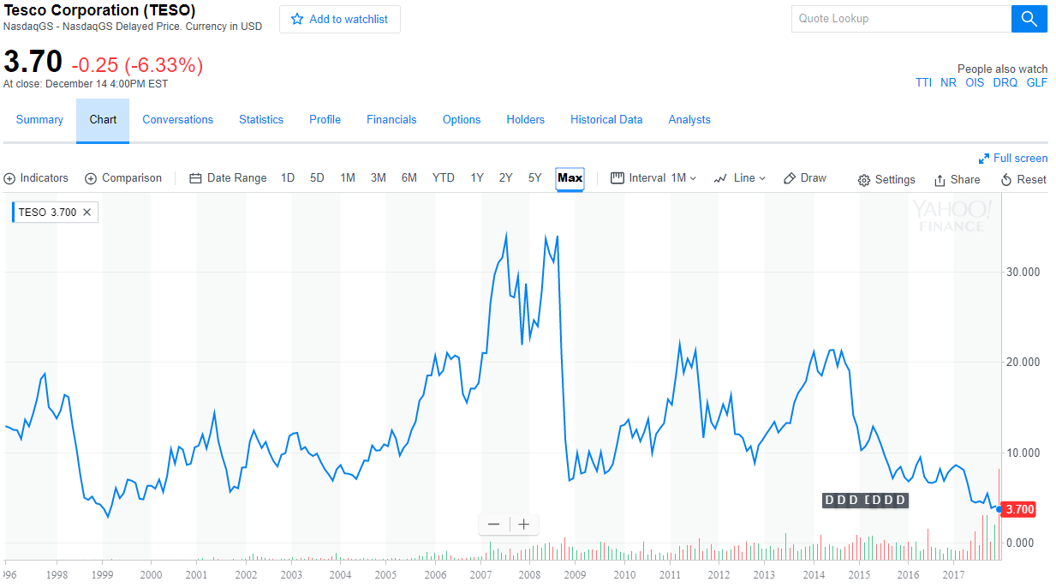
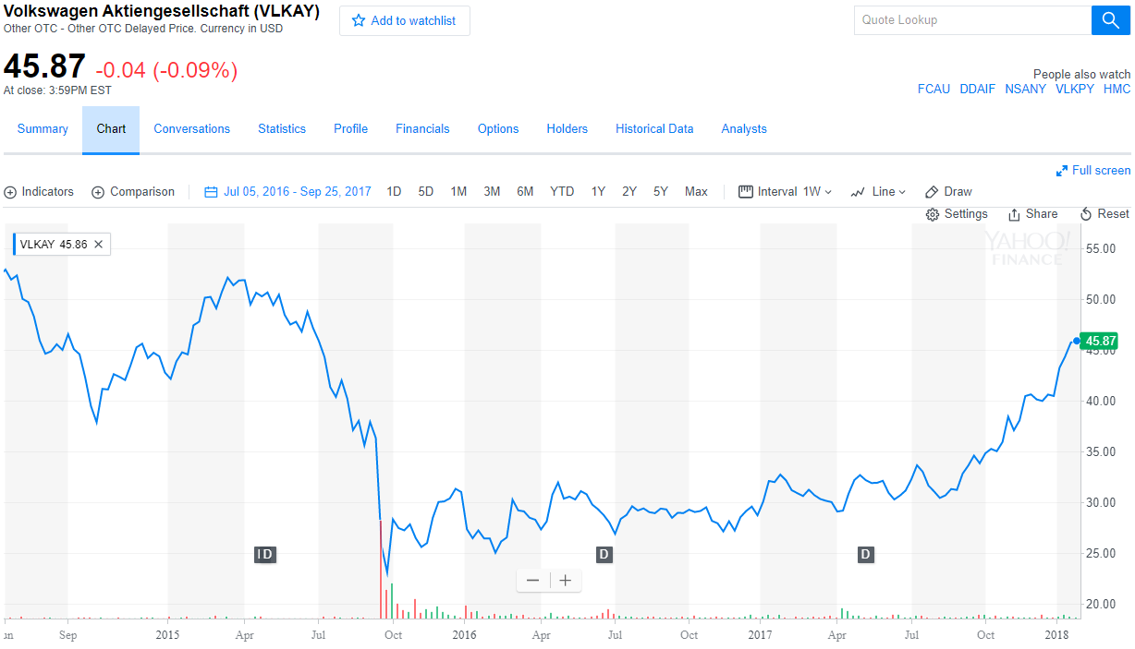
Additional Events
Samsung Galaxy phones explode
Mylan called to hearing for EpiPen pricing
Kobe Steel misrepresent financials
Tesco misrepresent financials
VW falsifies emissions

Slide 11
Process of proving the thesis with a Statistical Model using Machine Learning
Grouped news events into five categories:
Product Failure, Service Failure or Fraudulent Practice
Accounting and Financial Misrepresentation
Environmental or Ecological Hazzard
Human Health Hazzard
Impact to Key Executive
Defined Business Logic
A minimum of a 15% decline in price of any security within 1-week is an ‘event’
Any subsequent decline of that same security within 4-weeks of ‘the event’ is the same ‘event’
A 15% increase in the security price above the 26-week low after the ‘event’ is considered ‘the bounce’

Slide 12
Workflow

Slide 13
Methodology

Slide 14
Analysis

Slide 15
Analysis

Slide 16
Findings

Slide 17
Findings

Slide 18
Next Steps

